Slide 1
October 2023 release of Power BI apps on telemetry
Dynamics 365 Business Central

Slide 2
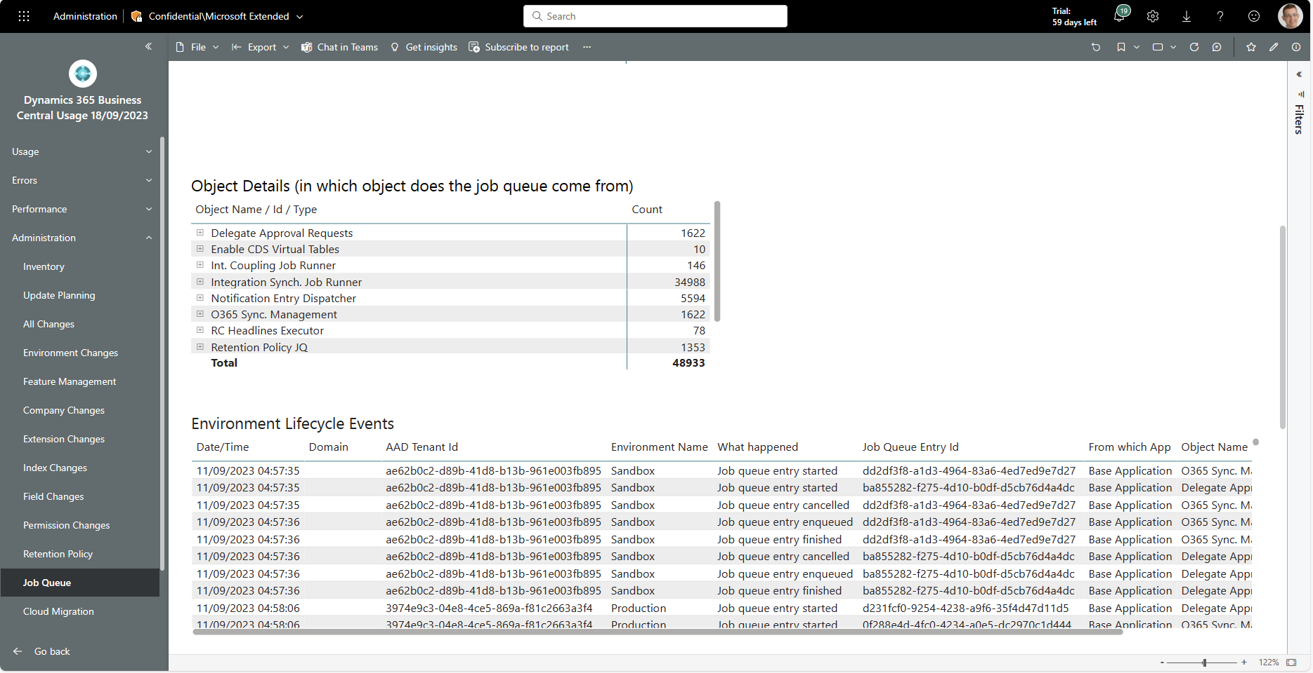
New administrator report: Job queue lifecycle
Find all job queue events (enqueued, started, stopped, failed, cancelled, retried, …) that happened across all customers.

Slide 3
Get the apps from Appsource
For environment telemetry https://aka.ms/bctelemetryreport
For app telemetry https://aka.ms/bctelemetry-isv-app

